Slide 1

Philip Kahn
project

Slide 2
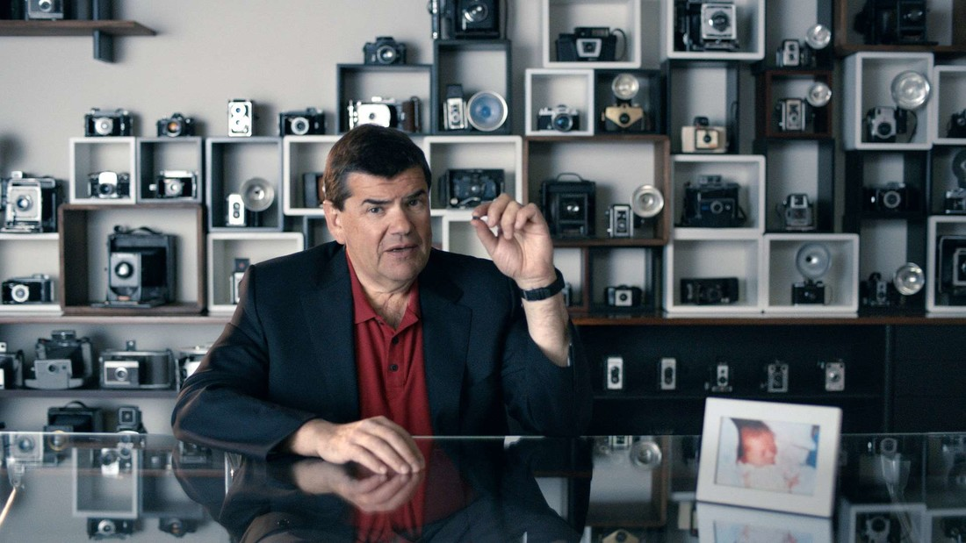
Philip Kahn
was born on March 16, 1952 (age 69) in Paris.
Studied in Switzerland and France.
Received a master's degree in mathematics and musicology.

Slide 3
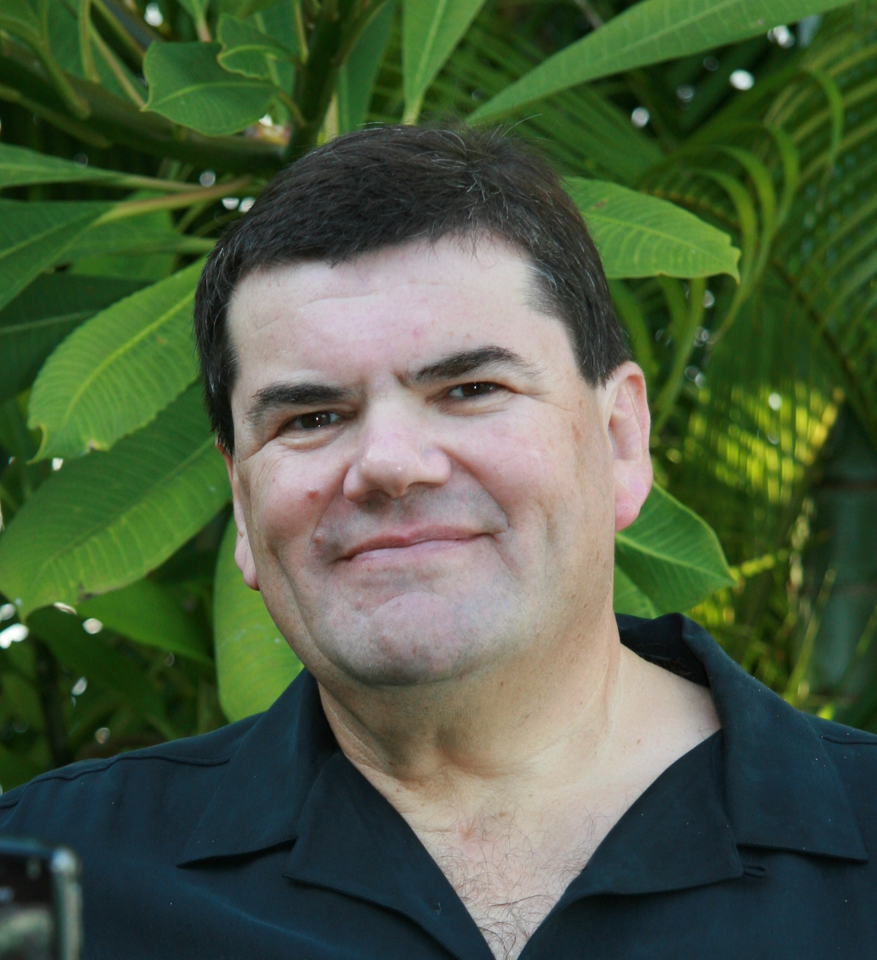
Creator of the first solution for instant photo sharing in public networks Software developer for the first personal computer based on a microprocessor Author of 230 patents in the field of artificial intelligence, smartphones, wireless communication, synchronization, medical technologies

Slide 4
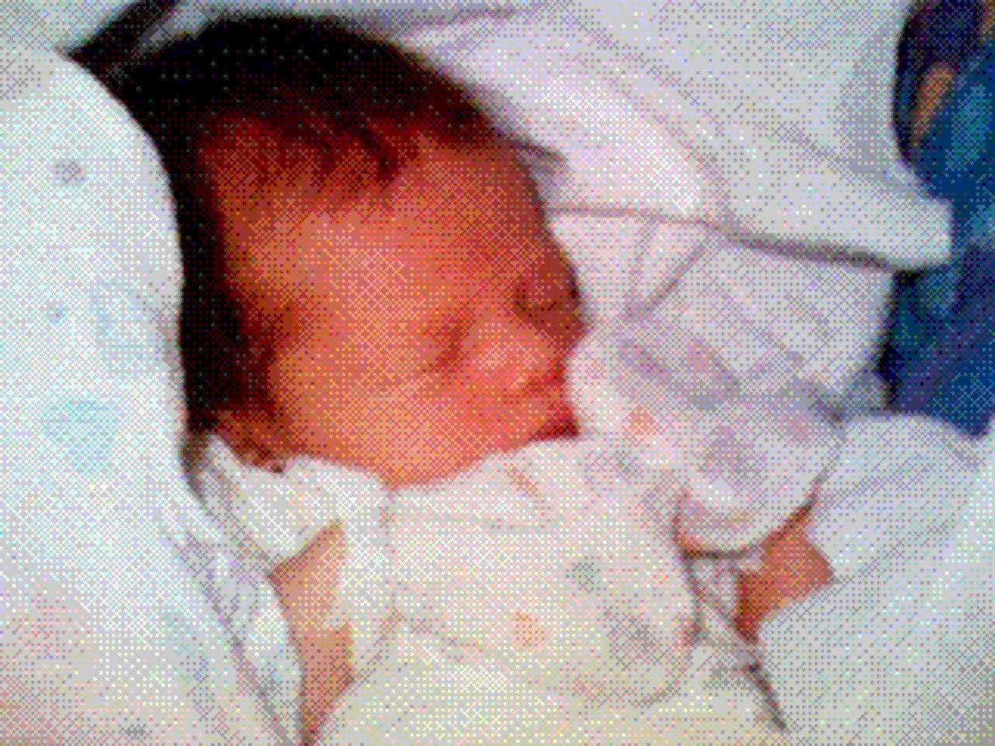
June 11, 1997
Santa Cruz
California

